Slide 1

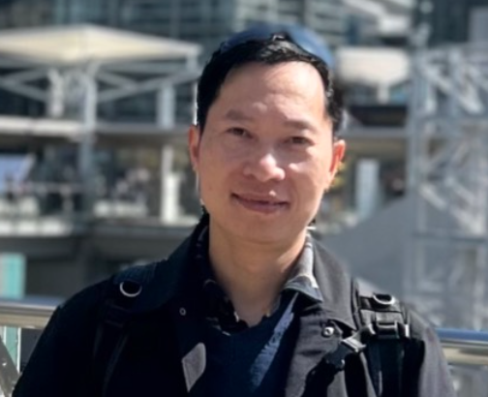
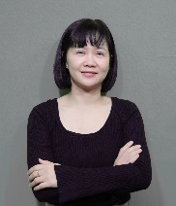











Public Finance Service Development Department (FSG) – Organizational Chart
HuyNQ23
HungNV1
NgaPV
Tanaka
HuyenHTP
BOD
ChiVTL
Kataoka
ThinhTX
HuyenHTP
SonPV12
QuynhHT3
ThinhTX
PhuongNX8
PhuPH3
AI Enablement
RA/HR
PMO
AWS,SWAT
CX
DX
CO
Public Service Department
Government (Ministries, Tax, Pension), Welfare, Public Healthcare, Smart City, Police...
Digital Finance Solution Department
Bank, Securities, Credit card , Payment & Fintech
Finance Core Service Department
Trust bank, Securities
NES/NTT Government and public sector
IBM(MUFG, SMBC), NEC-related(AI)
Trust bank: MUSK, CBJ, CITS-SMTB, SCSK-F
NES, NEC Police development / law enforcement infrastructure/ Education
Rakuten, DIR,SMTB, NRI
Securities : JIP, QES
NES Smart city/Smart safety/Media
Resona, other Banks
Others: HTC-F, ISIDJ, TDCS
ニアショア
沖縄、福岡、北海道
約100人
Others: Boostry, Paypay,CTC, ZHR, CAC,TDSL, TDEN
Salesforce Program MUSK, CITS

